Slide 1
A Unified Coding Framework for Distributed Computing with Straggling Servers
Songze Li ∗ , Mohammad Ali Maddah-Ali† , and A. Salman Avestimehr ∗
2016 IEEE Globecom Workshops (GC Wkshps)

Slide 2
INTRODUCTION
PROBLEM FORMULATION
MAIN RESULTS
PROPOSED CODED FRAMEWORK
CONVERSE
APPENDIX

Slide 3
1. INTRODUCTION
We propose a unified coded framework for distributed computing with straggling servers, by introducing a tradeoff between “latency of computation” and “load of communication” for some linear computation tasks.
latency of computation :MDS code
load of communication: CDC scheme
Matrix multiplication is one of the building blocks to solve data analytics and machine learning problems (e.g., regression and classification)
We term CDC approach as “Minimum Bandwidth Code”
We term the map approach using MDS code as “Minimum Latency Code”

Slide 4
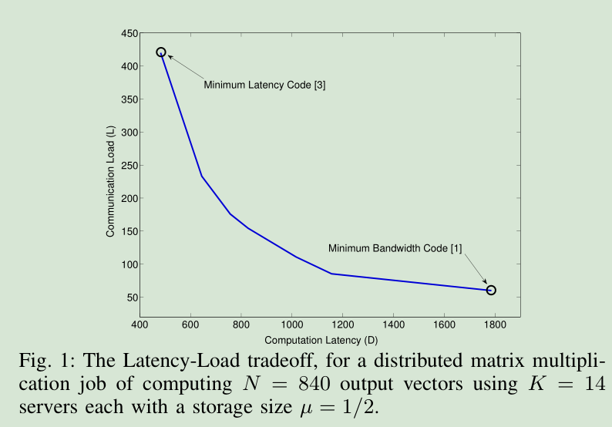
1. INTRODUCTION

Slide 5


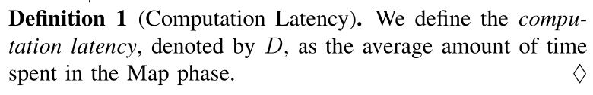
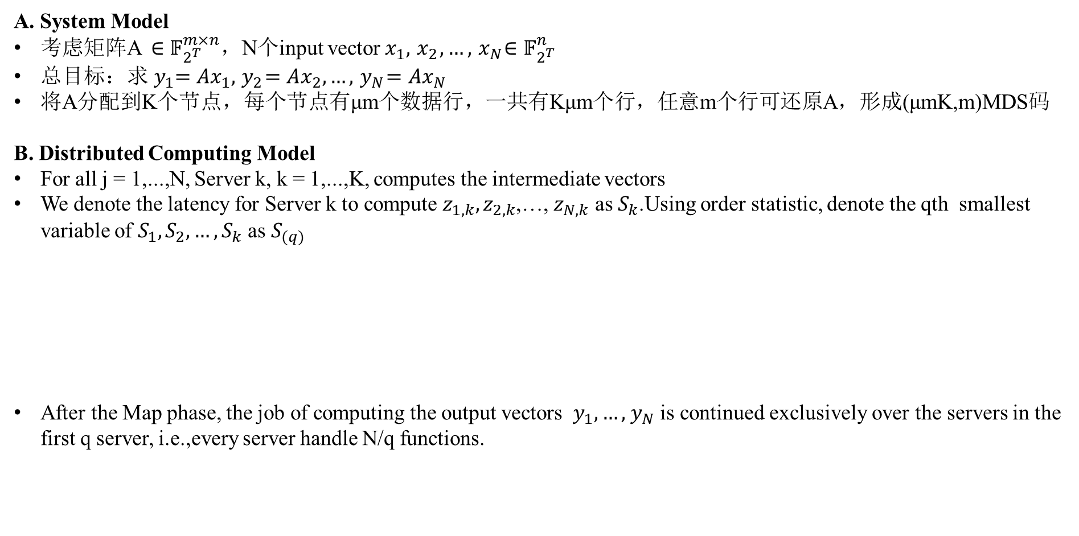
2. PROBLEM FORMULATION
A. System Model
考虑矩阵A $∈𝔽_{2^{T}}^{m×n}$，N个input vector${ x}_{1},{ x}_{2},…,{ x}_{N}∈𝔽_{2^{T}}^{n}$
总目标：求${ y}_{1}=Ax_{1},{ y}_{2}=Ax_{2},…,{ y}_{N}=Ax_{N}$
将A分配到K个节点，每个节点有μm个数据行，一共有Kμm个行，任意m个行可还原A，形成(μmK,m)MDS码
B. Distributed Computing Model
For all j = 1,...,N, Server k, k = 1,...,K, computes the intermediate vectors
We denote the latency for Server k to compute $z_{1,k},z_{2,k}$,…, $z_{N,k}$ as $S_{k}$.Using order statistic, denote the qth smallest variable of $S_{1},S_{2},…,S_{k}$ as $S_{(q)}$
After the Map phase, the job of computing the output vectors ${ y}_{1},…,{ y}_{N}$ is continued exclusively over the servers in the first q server, i.e.,every server handle N/q functions.

Slide 6
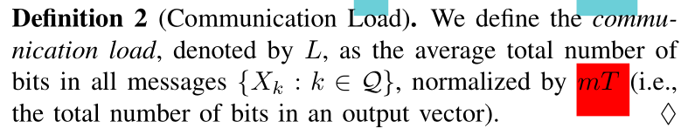
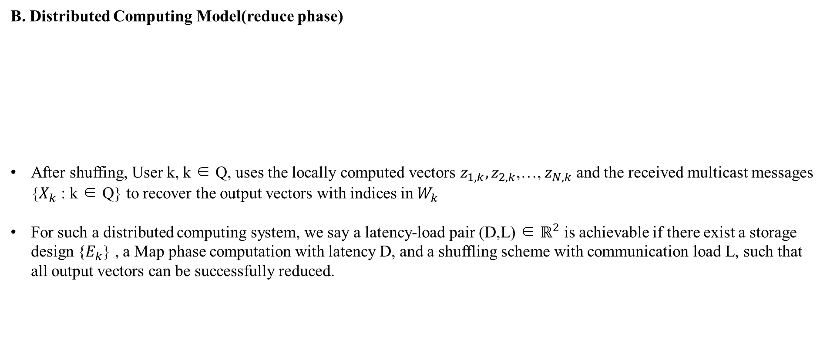
2. PROBLEM FORMULATION
B. Distributed Computing Model(reduce phase)
After shuffing, User k, k ∈ Q, uses the locally computed vectors $z_{1,k},z_{2,k}$,…, $z_{N,k}$ and the received multicast messages {$X_{k}$ : k ∈ Q} to recover the output vectors with indices in $W_{k}$
For such a distributed computing system, we say a latency-load pair (D,L) ∈ $ℝ^{2}$ is achievable if there exist a storage design {$E_{k}$} , a Map phase computation with latency D, and a shuffling scheme with communication load L, such that all output vectors can be successfully reduced.

Slide 7

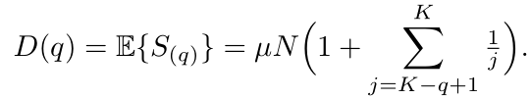
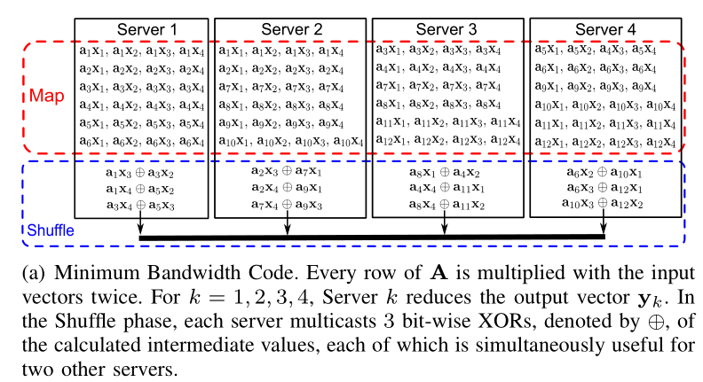

2. PROBLEM FORMULATION(Example)
m=12,N=4,μ=1/2,K=4
Map latency has a shifted-exponential distribution function
According to “A first course in order statistics”
Only Minimum Bandwidth Code(CDC scheme)
Computation latency:
Communication load:

Slide 8
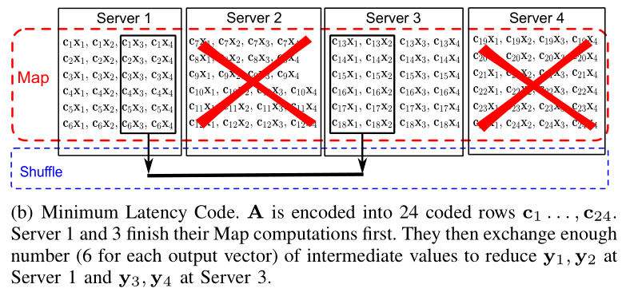


2. PROBLEM FORMULATION(Example)
m=12,N=4,μ=1/2,K=4
Map latency has a shifted-exponential distribution function
According to “A first course in order statistics”
Only Minimum Latency Code (MDS code)
Server1 finishes y1 and y2
Server3 finishes y3 and y4
Computation latency:
Communication load:

Slide 9
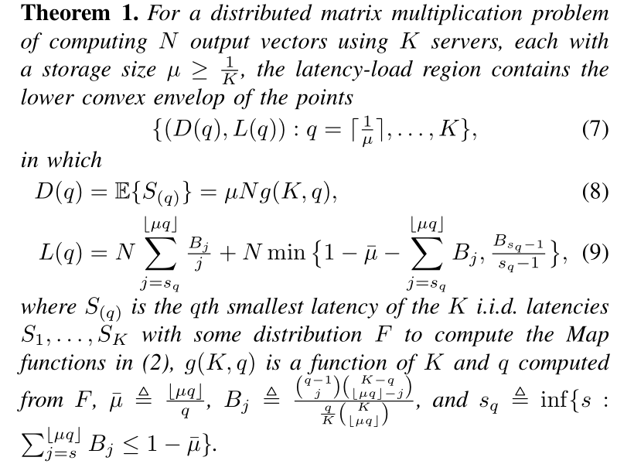


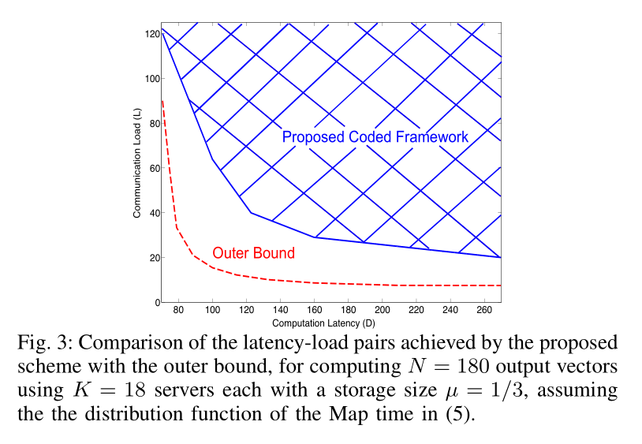
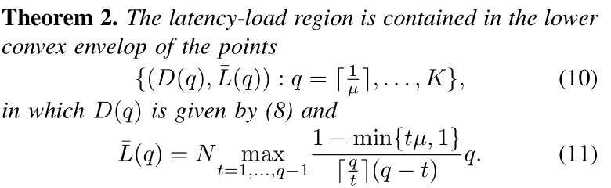

3.MAIN RESULTS
Minimum Latency Code
q=$\left\lceil \frac{1}{μ}\right\rceil$
Achieve
Minimum Bandwidth Code
q=K
Achieve

Slide 10
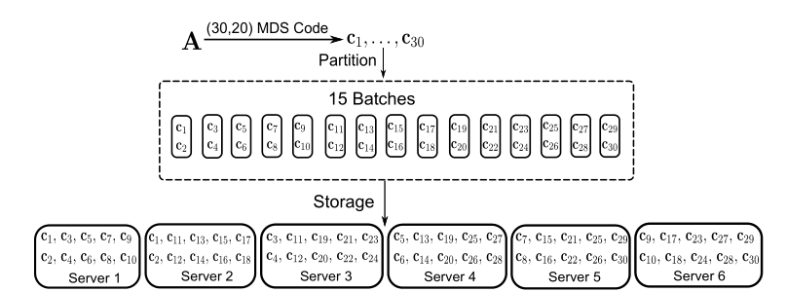

4. PROPOSED CODED FRAMEWORK（Example）
m=20, N=12, K=6, μ=1/2, q=4
Storage Design.
Achieving a (30,20)MDS code of the rows of A
Partition the 30 rows into 15 batches, each of size 2.each batch stored at 2 server exclusively.
Put the N=12 output vectors into q=4 servers，each server compute 3 output vectors.
考虑前4个server最先完成，server1要完成${ y}_{1}=Ax_{1},{ y}_{2}=Ax_{2},{ y}_{3}=Ax_{3}$。
对每一个y, server1已经有10行，还需要{$c_{11}, c_{12},…,c_{30}$}的任意10行

Slide 11
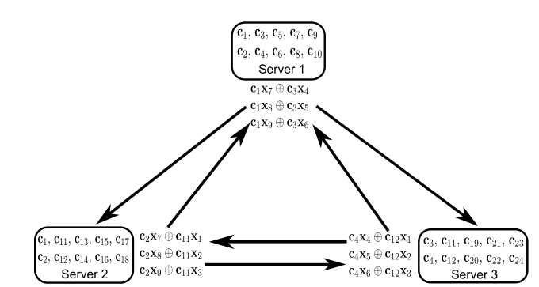

4. PROPOSED CODED FRAMEWORK（Example）
m=20, N=12, K=6, μ=1/2, q=4
Coded Shuffle.
Consider the first 4 servers.
We first group the 4 servers into 4 subsets of size 3 and perform coded shuffling within each subset
Server1 can recover $c_{11}x_{1},c_{11}x_{2},c_{11}x_{3},c_{12}x_{1},c_{12}x_{2},c_{12}x_{3}$（$c_{11},c_{12}$）
Server1 can recover $c_{13},c_{14}$ and $c_{19}, c_{20}$ from another 2 subsets of size 3.
Since m = 20, server1 only get 10+6=16 rows of A.
The remaining 4 rows must be transmitted directly.
L=9*4+4*3*4=84

Slide 12
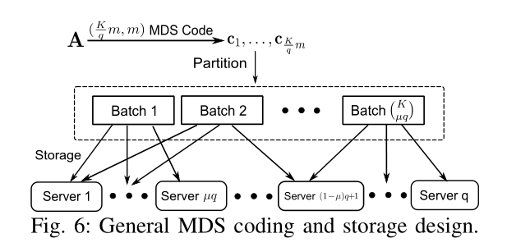

4. PROPOSED CODED FRAMEWORK（General Scheme）
Storage Design.
First use a ($\frac{K}{q}m,m$)MDS code
Partition the $\frac{K}{q}m$ rows into $\left({K \atop μq}\right)$ batches
Map Phase Execution.
Wait for the fastest q servers to finish their Map computations before halting the Map phase
The setting ensure any q servers has m different rows

Slide 13
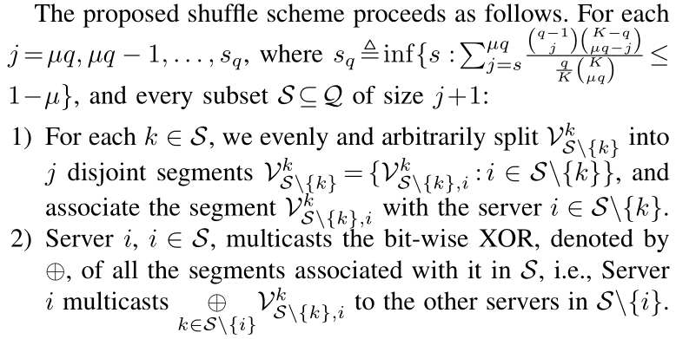
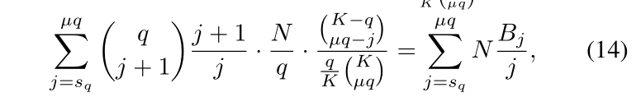



4. PROPOSED CODED FRAMEWORK（General Scheme）
Coded Shuffle.
挨个考虑j是由于一次迭代每个server无法还原m个rows。
迭代j直到每个server能够还原m个rows

Slide 14
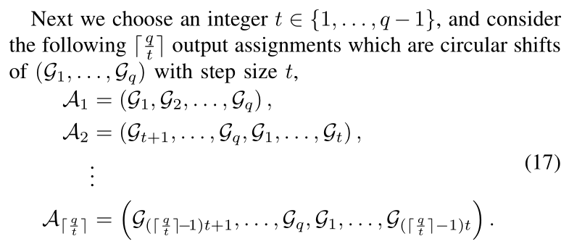
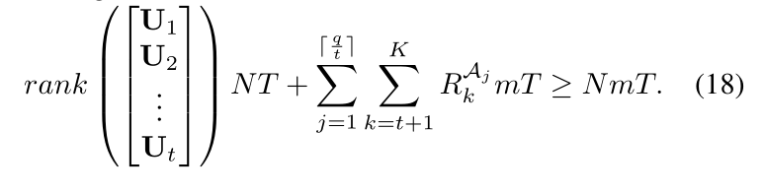

5. Converse
Partition ${ y}_{1},{ y}_{2},…,{ y}_{N}$ into q groups $𝒢_{1},𝒢_{2},…,𝒢_{q}$
For a shuffling scheme admitting an output assignment $𝒜$, we denote the message sent by Server k ∈ {1,...,q} as $X_{k}^{𝒜}$,with a size of $R_{k}^{𝒜}mT$ bits.
Consider the first t servers

Slide 15
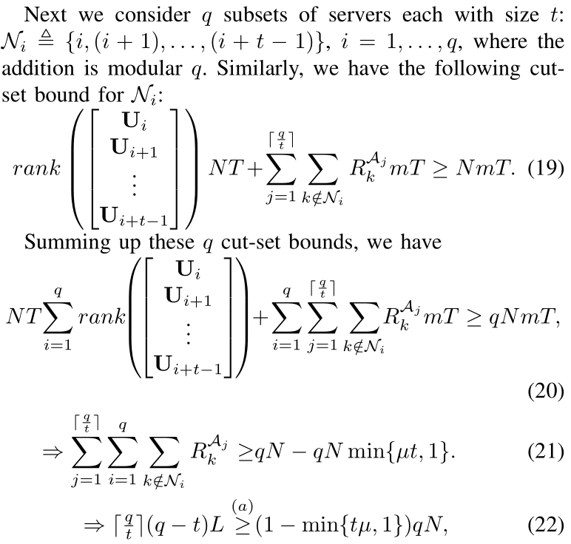
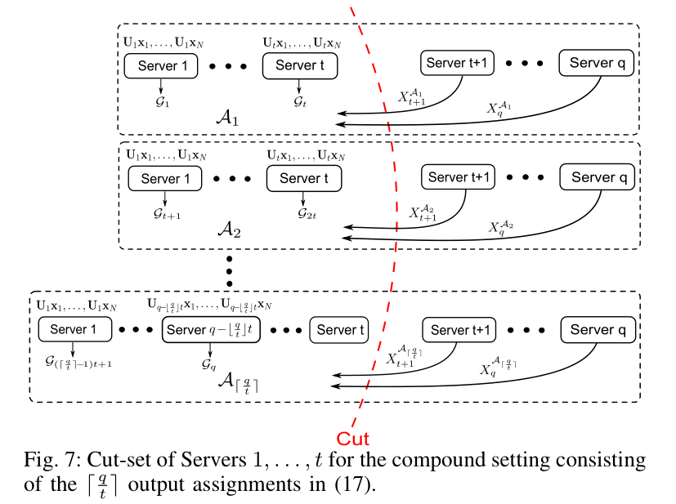



5. Converse
构造q$R_{k}^{𝒜}$=L
q(q-t)$R_{k}^{𝒜}$=(q-t)L

Slide 16
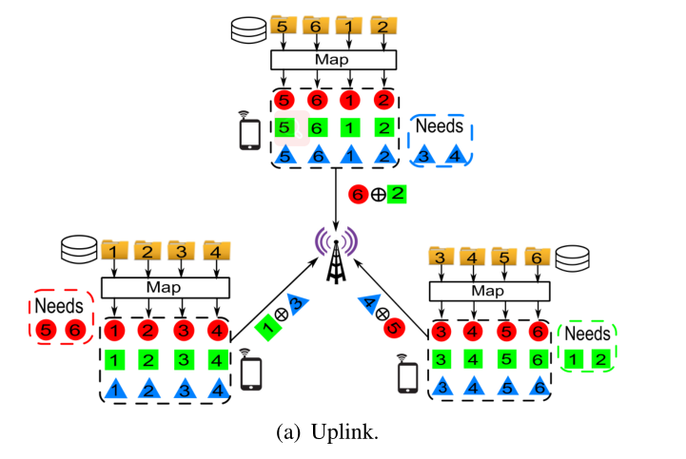
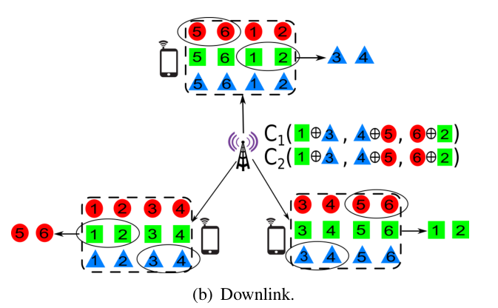
1. INTRODUCTION(Motivating Example,N=6,K=3,Q=3)
每一个文件都将产生Q=3个中间值
广播μK=2个线性组合
换成矩阵乘法，用MDS码
考虑stragglers，考虑前q个率先发送给ap的节点
用次序统计量，时间期望和传输量的tradeoff(以q为输入)
适用性是问题。

Slide 17
1. INTRODUCTION(Motivating Example,N=6,K=3,Q=3)
手机导航系统，每个用户需要找到两点之间最短的路径。输入为两点的地址，每个用户的中间值为基于该用户所拥有的数据集的所有可能的路线，每个用户需要找到最短的路径(需要基于两点的所有的路径)。
图像识别系统，输入可以是图像的特征，中间值是输入的特征与所有图片的特征比对，整个数据集是目标的特征库。每个用户要找到输入特征与某个特征最接近的图。(需要基于输入图像的所有比对)
过滤系统。比如想订饭店，输入为用户喜欢的饭店类型，中间值为基于该用户数据集的所有饭店的信息（地址、电话、图片）。每个用户要得到所有的饭店信息
矩阵运算（更底层）？
每个用户都有任务，如果考虑stragglers，有一些慢用户就得不到反馈。
主要问题还是straggler问题(矩阵计算)是把所有节点看成一个整体。无线框架下注重的是每个用户(节点)的任务。

